Slide 1
Using Reddit Submissions to Predict TRX price

Slide 2
INTRODUCTION
Reddit is social news aggregation and discussion website
Reddit is broken up into ‘subreddits,’ which encompass a wide range of topics
Colloquially referred to as the front page of the internet, Reddit contains a plethora of text data that could be used for sentiment analysis

Slide 3
CHALLENGE
The purpose of this project is to use Reddit data to predict the movement of a cryptocurrency, Tron (TRX)
This will involve scraping data from Reddit and the price of TRX from a currency exchange site
After collecting and preprocessing this data, determining the daily sentiment, I will use a RNN-LSTM to predict the price movement of this cryptocurrency

Slide 4
METHODOLOGY
Data collection
1. Use the Reddit API to collect >1 year of submissions to the VET subreddit
2. Collect the Closing price of TRX from Coinmarketcap.com using Beautiful Soup for the same period
Reddit Submission Sentiment Analysis
1. Determine polarity of submission titles and take the average daily polarity and subjectivity
RNN-LSTM Phase
1. Use a LSTM to predict the movements of the cryptocurrency based off daily polarity, sentiment and subjectivity with the following day

Slide 5
Project Flow
Cryptocurrency data
Reddit
Data Collection
Sentiment Analysis, Data Formatting
Data Formatting
LSTM using price, sentiment and polarity to predict next day’s movements
Understanding if Reddit submission’s text has predictive power for TRX’s price movement

Slide 6
TextBlob Sentiment Analysis
The textblob is a pretrained text processing library, which provides useful out-of-the-box natural language processing capabilities
One property of textblob is generating the polarity and subjectivity score. Polarity score is a number between -1 and 1 which indicates a text’s sentiment as positive or negative, -1 being the most negative and 1 being the most positive
Subjectivity is measured from 0, which is completely objective to 1, which is rated as purely subjective
Aggregating the sentiment will be done as follows:
1. Pull the most recent 1000 submissions to in the TRX subreddit and store in a dataframe
2. Compute the polarity and subjectivity using textblob and store as columns
3. Group the data by day, aggregating by the mean
4. Merge the polarity and subjectivity to the TRX price dataframe

Slide 7
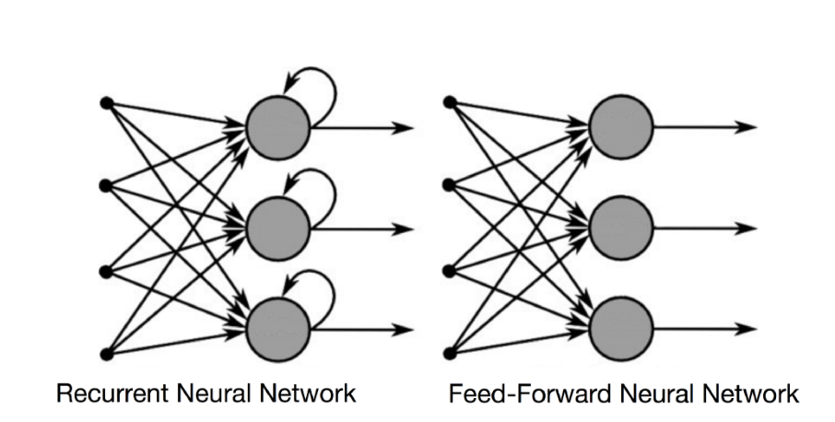
RNN-LSTM
Long Short -Term Recurrent Neural Networks are a deep learning tool which can predict sequential (time-series) data effectively.
RNNs combine the feed-forward nature of an artificial neural network with the ability to ‘remember’ the previous inputs in addition to the current inputs
Python’s Keras library contains an effective out-of-the-box LSTM-RNN algorithm, built on top of TensorFlow or Theano

Slide 8
Using the LSTM
The input dataframe will contain the Close (price) and the sentiment analysis and the next day’s close as the target variable. The following steps will be performed with this dataframe:
Scale the data so it can be processed effectively with the Keras library
Create a data structure with 60 time steps which will allow the neural network to ‘look back’ for predicting future prices
Split the data into testing and training sets
Initiate the LSTM
Use drop out regularization to avoid overfitting (ignore x% of neurons in the LSTM during each training iteration (forward and back)
Add several layers for higher dimensionality
Compile the network using the Adam (Stochastic Gradient Descent) optimizer and evaluate the model using mean squared error
Fit the model to the training data
Make predictions with the model and plot the results

Slide 9
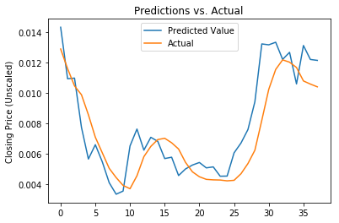
RESULTS
Type | Mean Squared Error | Mean Absolute Error
Training | 0.00061 | 0.00034
Test | 0.0118 | 0.092

Slide 10
Limitations and Lessons Learned
Sentiment analysis
Many users in Reddit forums use ironic and sarcastic speech, which will likely not be interpreted correctly by natural language processing
The language is constantly evolving, particularly online. Pretrained datasets tend to be far behind this evolving lexicon
Reddit Data
Reddit’s API only allows for the 1000 most recent submissions to be pulled. To create a more robust model, our corpus would be significantly larger

